Slide 1


Noise Pollution Insights
Presented by Cogent Co.
Smart Cities Hackathon 2021
© Cogent Co. 2021
Notes:
Hello, I am Reza representing Cogent Company. We are presenting ‘Noise Pollution Insights’ for the “Smart Cities Hackathon”.

Slide 2

PROBLEM
The European Environment Agency estimates that noise is responsible for 72,000 hospital admissions and 16,600 premature deaths every year in Europe alone. Our focus is on Singapore with 5.7 million population.
Cost + App
Singapore
UN + WHO + WEF
Unique Proposal
Market Dynamic
Humanitarian Bridge
© Cogent Co. 2021
Notes:
Our problem is that the environment agency estimates that noise is responsible for 72,00 hospital admissions in Europe alone, However our main focus is on Singapore with 5.7 million population.
We are different because we will provide a unique proposal to save the govt time and money and provide a better health assessment for the population.
Singapore is facing a severe issue of urban noise pollution. More than 80% of its citizens live within short distances between transportation. Around 70,000 complaints of excessive noise are made every year.

Slide 3
SOLUTION
A mobile application for users to transmit noise data on GPS location and receive health predictions
Smart Transportation
Dashboard for Environmental Agencies to take actions based on different alert levels
© Cogent Co. 2021
Notes:
First, Our solution to the problem for smart Transportation is that the individual can identify noise pollution in the environment and receive Health predictions in the short and long term named Pollution Watch
Second, is that the environment agency can identify alert levels using a dashboard named Pollution Insights

Slide 4
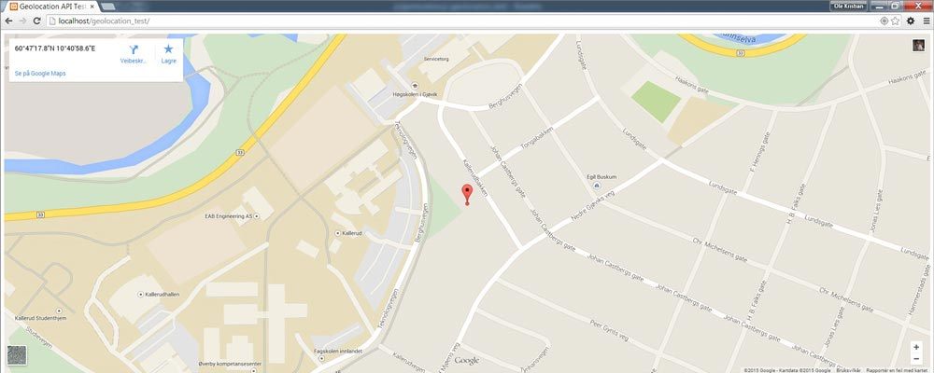

MONETIZATION
Smart Transportation Market size (Singapore) 2020: 21.3M USD
Red Zone – Greatest Monetization
Amber Zone – Least Monetization
Green Zone – No Monetization
© Cogent Co. 2021
Notes:
Globally, our monetization findings shows that monitoring the noise market was valued at over 700M in 2019 and is projected to reach over 950M by 2027 which is growing at a rate of 4.21%.
Smart Transportation Market size (Singapore) 2020: 21.3M USD
In Singapore the greatest monetization lies within the red zone which are the urban and highly densed area. The least monetization lies in Amber zone and no monetization in green zone due to no complaints.

Slide 5
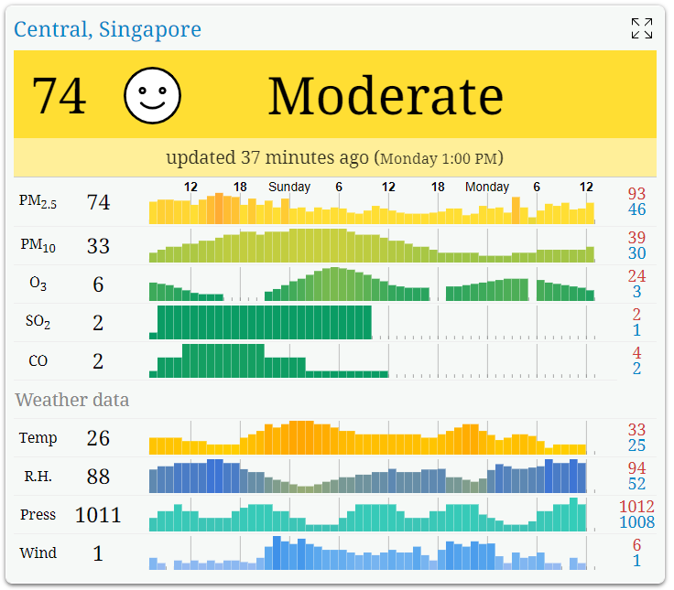
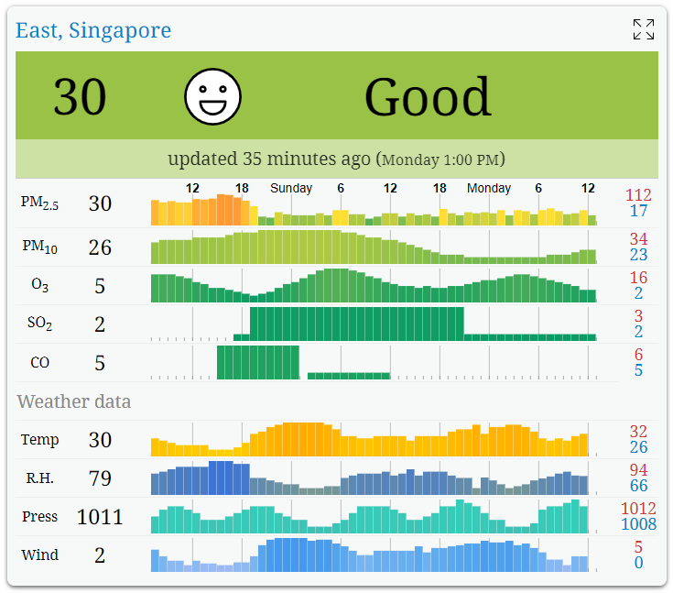
UNDERLYING MAGIC Central Singapore
Before
After
After Using the product
© Cogent Co. 2021
Notes:
The underlying magic of our proposal, that we don’t show to the public is the impact it has on the real-time noise pollution index after using the product.
This is a visualization showing for central Singapore before a moderate index of 74 to a good index of 30.

Slide 6
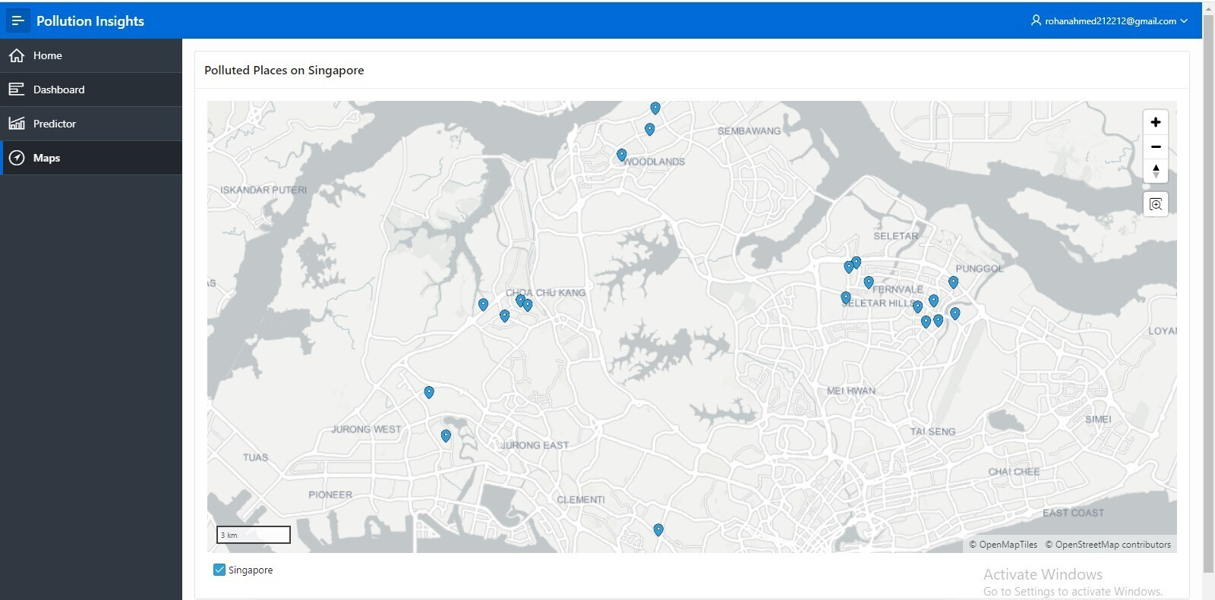
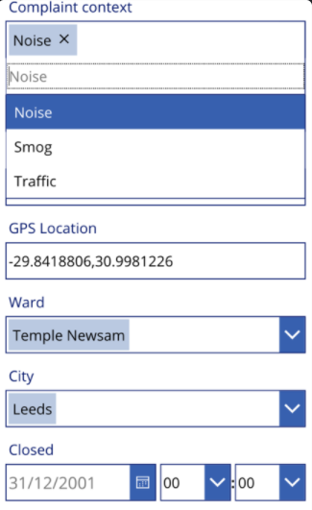

Mobile App|Noise Pollution Watch
© Cogent Co. 2021
Notes:
Introducing our Noise pollution watch. The user can submit noise signals in dB and on GPS location. The app also integrates with mapping technology to show polluted places within same vicinity.

Slide 7
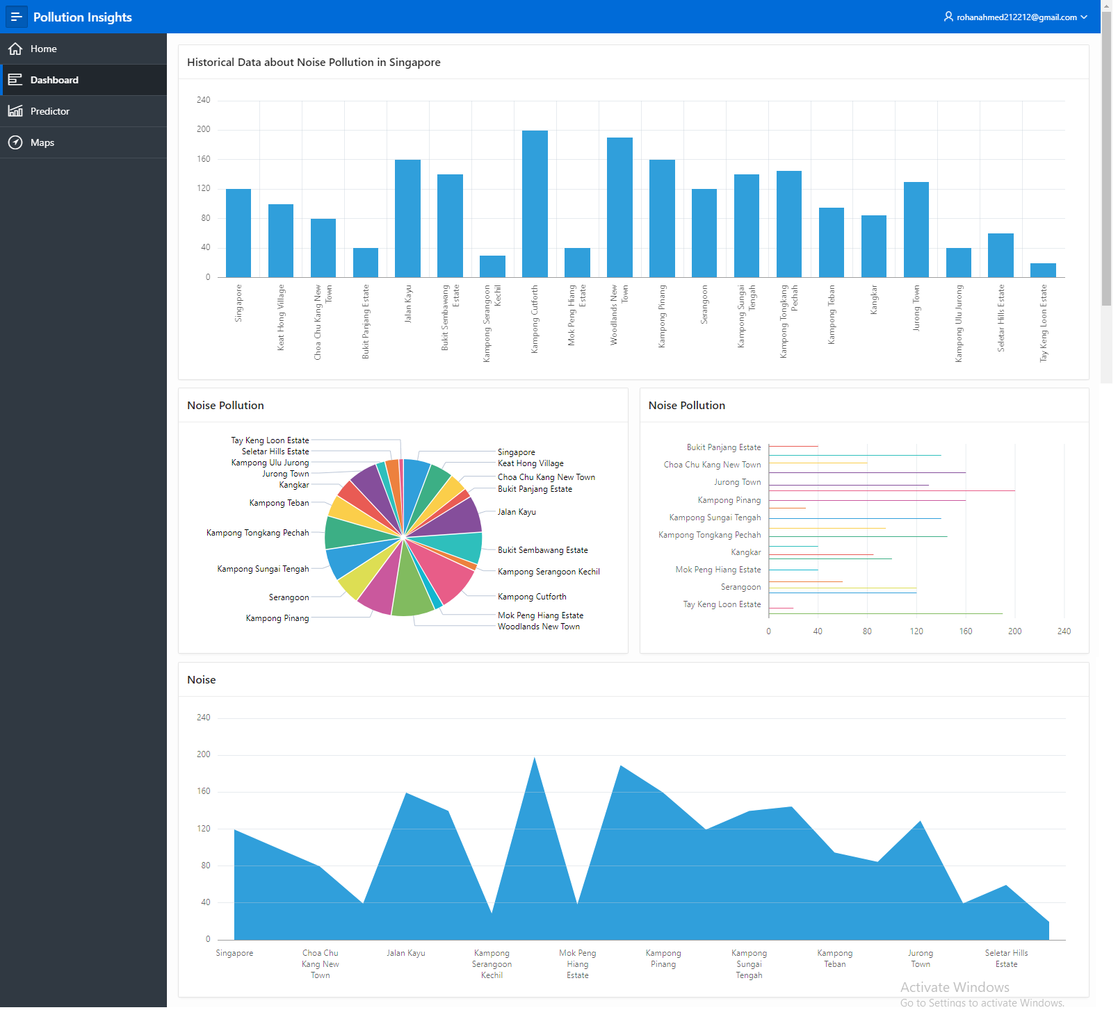
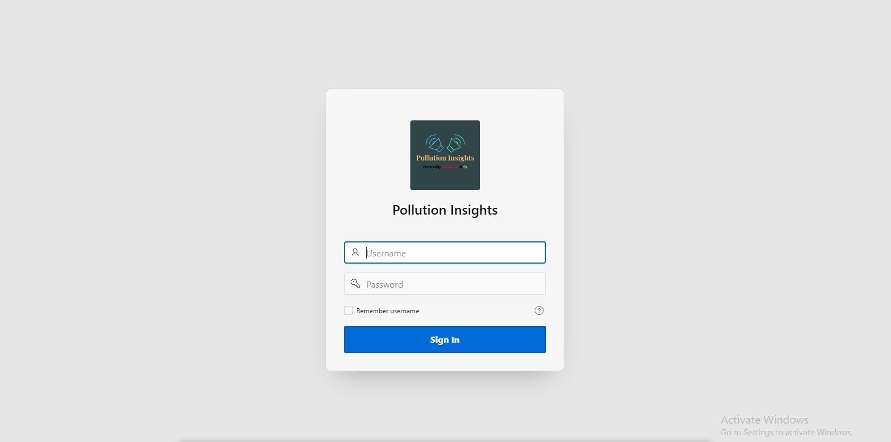


Dashboard | Noise Pollution Insights
© Cogent Co. 2021
Notes:
Introducing our Noise pollution Insights. The purpose of the dashboard is to enable environment agency with greater insight on noise polluted data collected by the mobile app in real-time. The dashboard can also show different alert level for agencies to take actions on and make better informed decisions.

Slide 8
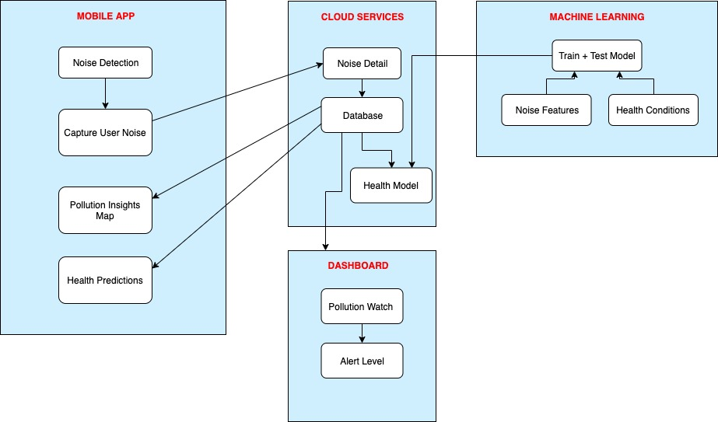




CONCEPTUAL ARCHITECTURE
© Cogent Co. 2021
© Cogent Co. 2021
Notes:
Here is our conceptual architecture showing the integration of all the components described such as the mobile app to the cloud services to the dashboard and to our ML models for making health predictions.

Slide 9
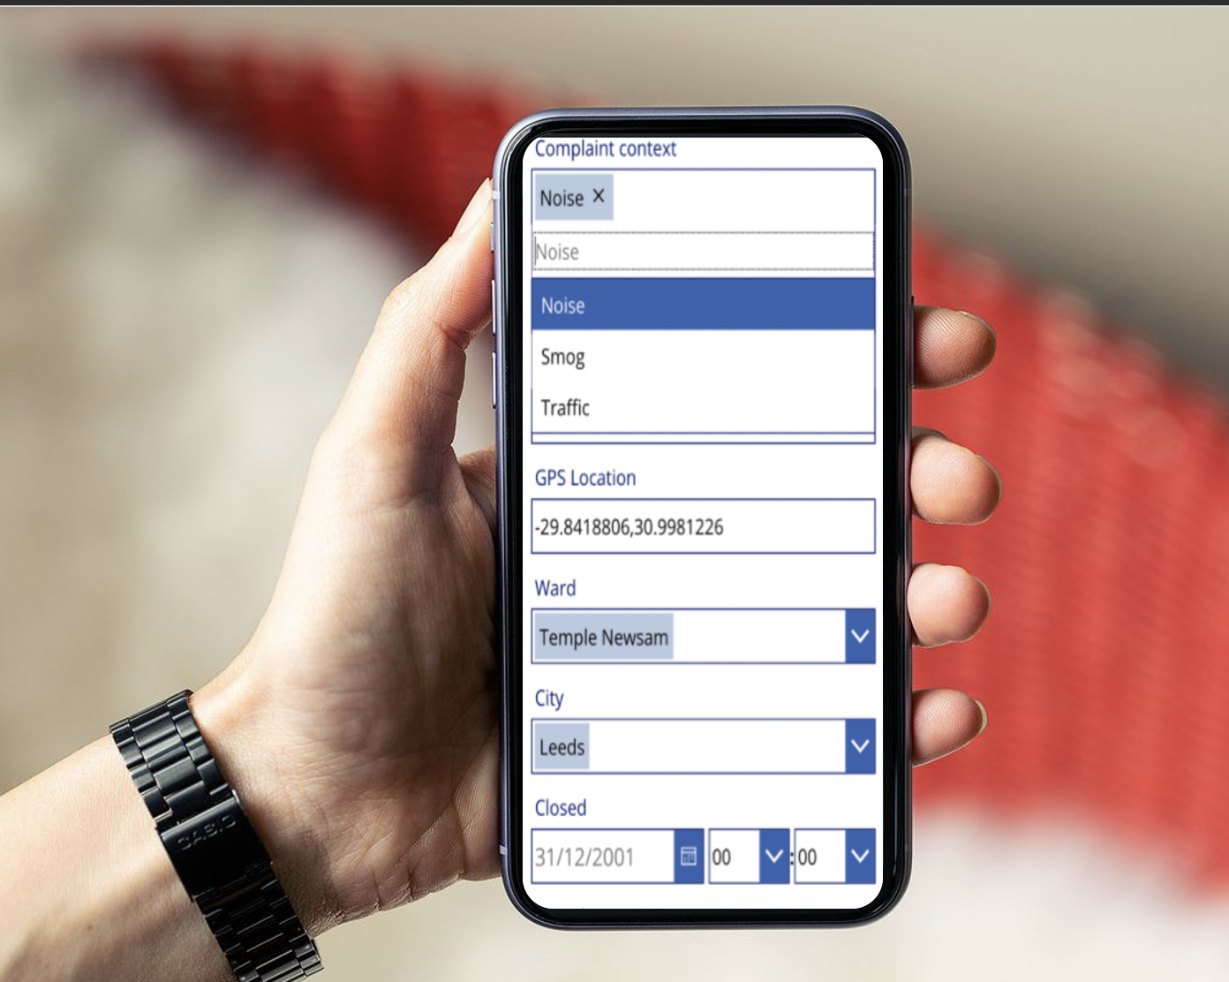
BENEFITS
Government Saves Money!
Cost Reduction
Health Impact
Environmental Agencies
Carbon Footprint
Transportation
Real Estate Values
© Cogent Co. 2021
Notes:
Overall, we conclude the benefits of using both Pollution Watch and Pollution Insights to save the government time and money.
In addition, other benefits include:
Cost Reduction
Positive Health Impact
Informed decision making for Environmental Agencies
Reduce Carbon Footprint
Smart Transportation
Higher Real Estate Values

Slide 10
ROADMAPS
Budget and Finance Approval
Project Implementation
Data Privacy
Connectivity
Noise data from mobile app to Cloud services in real-time
Deployment in 10 – 12 weeks
Scalability
Automatically expand to include other market segments/regions
Integrate with other pollution data
User Participating Incentives
Earn points for noise transaction
Future Predictions (Machine Learning)
Health Model
Real Estate Model
Complaint Model
Climate Model
Environmental Actions
Re-allocate funds
Notify the agencies
Consider preventive measures
© Cogent Co. 2021
Notes:
Going Forward, our roadmap ahead is shown in the following verticals. Budget and Finance Approval
Connectivity
Scalability
User Participating Incentives - Earning points for noise transaction
Future Predictions (Machine Learning)
Health Model
Real Estate Model
Complaint Model
Climate Model
Environmental Actions

Slide 11







Project Members
Reza Abasaltian
Sheetal Gour
Greg Melson
Khai Fahmi Zaki
Nidhi Shrivastava
Rohan Ahmed
Anum Zeeshan
Sridhar Mothe
© Cogent Co. 2021

Slide 12

Project Mentors
We acknowledge your effort and time.
Saif Haque
Alistair Hofert
© Cogent Co. 2021

Slide 13
REFERENCE
https://www.iberdrola.com/environment/what-is-noise-pollution-causes-effects-solutions
https://papers.ssrn.com/sol3/papers.cfm?abstract_id=918727
https://www.nea.gov.sg/our-services/pollution-control/noise-pollution/overview
https://www.straitstimes.com/singapore/housing/sounds-awful-cant-sleep-cant-talk-because-of-noise
https://aqicn.org/city/singapore/central/
https://aqicn.org/api/
https://data.mendeley.com/datasets/cbjxbhzn43/1
© Cogent Co. 2021

Slide 14
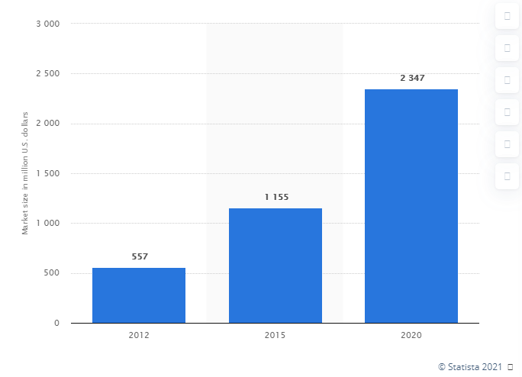
Appendix
Figure: Smart transport market size in Asia Pacific from 2012 to 2020
© Cogent Co. 2021

